Slide 1
MICRO CREDIT FINANCE PROJECT ON TELECOM
Presented by--
Avinash Singh

Slide 2
PROJECT DETAILS
Project Source : FlipRobo Technologies
Mentor : Nitin Mishra
Guidelines taken from : Youtube, Medium
Platform used : Python Notebook from Google Colab.

Slide 3
MICRO FINANCE CREDIT INFO
Microfinance is a category of financial services targeting individuals and small businesses who lack access to conventional banking and related services.
Microfinance services are designed to reach excluded customers, usually poorer population segments, possibly socially marginalized, or geographically more isolated, and to help them become self-sufficient.
Microfinance was defined initially as the provision of microloans to poor entrepreneurs and small businesses lacking access to credit.
The two main mechanisms for the delivery of financial services to such clients were: (1) relationship-based banking for individual entrepreneurs and small businesses and (2) group-based models, where several entrepreneurs come together to apply for loans and other services as a group.

Slide 4
DATA PREPROCESSING
The first step in the data pre-processing is to obtained the whole information about the dataframe including the index dtype and columns, non-null values and memory usage.
Next step is t do EDA which include count plotting, the target column “Label”, visualize:
Average main balance account vs loan payback rate within 5days.
Frequency of main account recharged in last 30 days vs loan payback rate within 5 days.
Number of loans taken by user in last 30 days vs loan payback within 5 days.
Dropping Unnamed:0,msisdn,pcircle,pdate column because it does not give any predictive information.
On verifying the correlation among the data, some of the feature seem to be highly correlated through data, so I drop it to remove the ambiguity while operations

Slide 5
PERFORMANCE METRICS
As this is a imbalanced data set. The most important metrics to be taken into consideration are as follows:
F1-Score
Precision
Recall
ROC-AUC Curve

Slide 6
APPLIED ALGORITHMS
Following are the algorithms that I applied on this dataset
Logistic Regression
GaussianNB
DecisionTreeClassifie
KNeighborsClassifier
RandomForestClassifier
BaggingClassifier

Slide 7
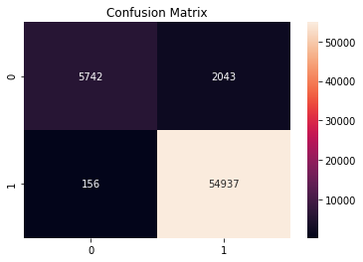
BEST MODEL
Final model is Random Forest with hyper parameter tuning
Accuracy = 0.96
Precision = 0.964
Recall = 0.99
F1 Score = 0.98

Slide 8
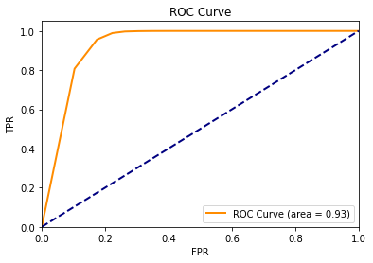
ROC-AUC GRAPH OF BEST MODELS

Slide 9
THANK YOU

